Slide 1
Sharif University of Technology
Department of Computer Science and Engineering
Lec. 2:
Basic Concepts
Real-Time Computing
S. Safari
Fall 2023

Slide 2
Introduction
A process is a computation that is executed by the CPU in a sequential fashion.
  In this course, the term process is used as synonym of task and thread.
Concurrent tasks means tasks that can overlap in time.
  When a single processor has to execute a set of concurrent tasks the CPU has to be assigned to the various tasks according to a predefined criterion, called a scheduling policy.
  The set of rules that, at any time, determines the order in which tasks are executed is called a scheduling algorithm.
  The specific operation of allocating the CPU to a task selected by the scheduling algorithm is referred as dispatching.

Slide 3
Introduction (2)
A task that could potentially execute on the CPU can be:
  In execution (if it has been selected by the scheduling algorithm).
  Waiting for the CPU (if another task is executing).
Active task: A task that can potentially execute on the processor, independently on its actual availability.
  Ready task: A task waiting for the processor.
  Running task: The task in execution.

Slide 4
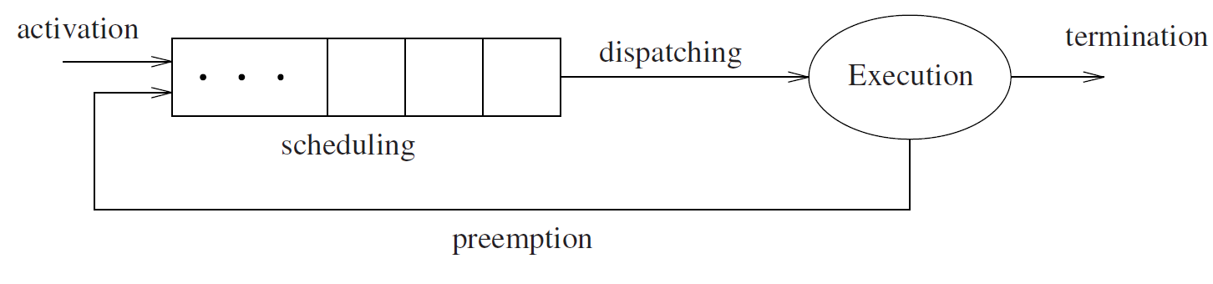
Introduction (3)
All ready tasks waiting for the processor are kept in a queue, called ready queue.
  Operating systems that handle different types of tasks may have more than one ready queue.
  The operation of suspending the running task and inserting it into the ready queue is called preemption.

Slide 5
Preemption
In dynamic real-time systems, preemption is important for three reasons [SZ92]:
  Tasks performing exception handling may need to preempt existing tasks so that responses to exceptions may be issued in a timely fashion.
  When tasks have different levels of criticality (expressing task importance), preemption permits executing the most critical tasks, as soon as they arrive.
  Preemptive scheduling typically allows higher efficiency, in the sense that it allows executing real-time task sets with higher processor utilization.
Preemption destroys program locality and introduces a runtime overhead that inflates the execution time of tasks.

Slide 6
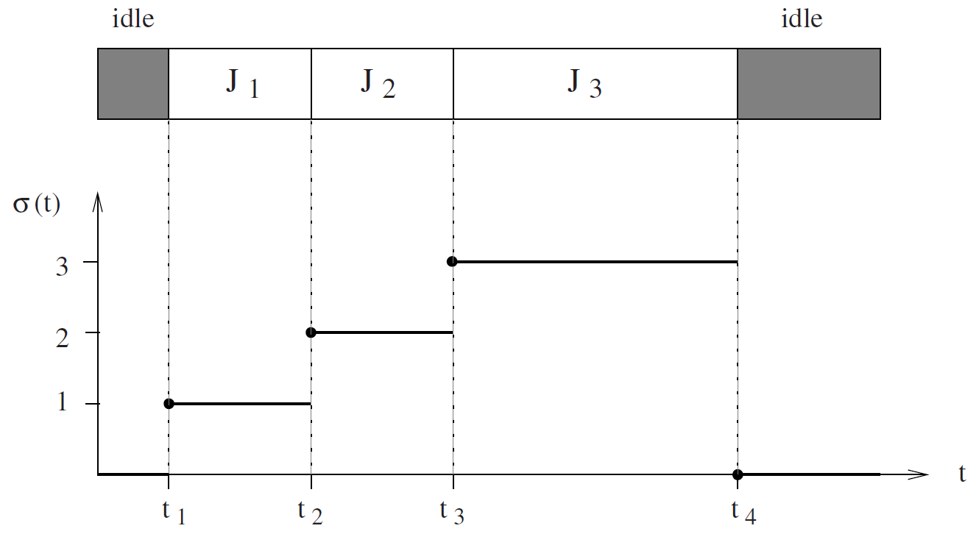
An Example of Schedule
An example of schedule obtained by executing three tasks: J₁, J₂, J₃.
At times t₁, t₂, t₃, and t₄, the processor performs a context switch.
Each interval [t_{i}, t_{i+1}) in which σ(t) is constant is called time slice. Interval [x, y) identifies all values of t such that x ≤ t < y.

Slide 7
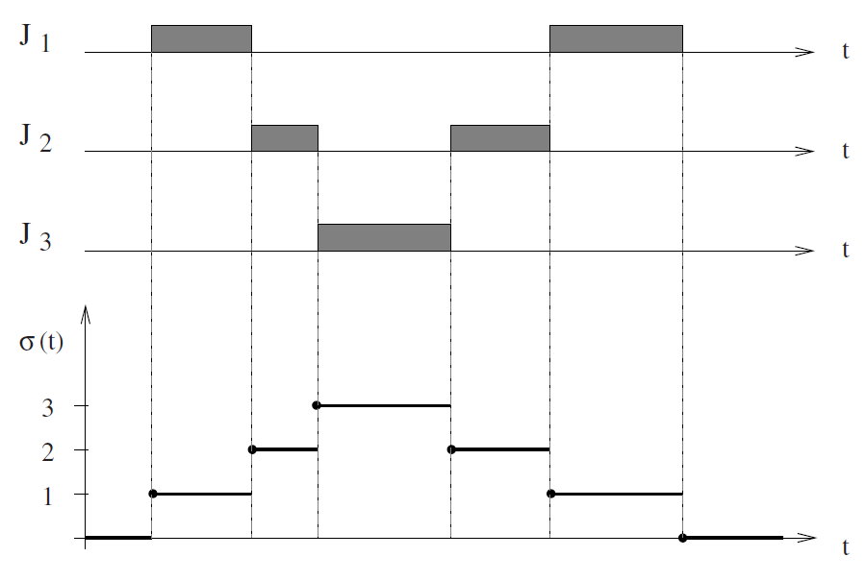
An Example of A Preemptive Schedule
A preemptive schedule is a schedule in which the running task can be arbitrarily suspended at any time, to assign the CPU to another task according to a predefined scheduling policy.

Slide 8
Feasible Schedule and Schedulable Tasks
In preemptive schedules, tasks may be executed in disjointed interval of times.
A schedule is said to be feasible if all tasks can be completed according to a set of specified constraints.
A set of tasks is said to be schedulable if there exists at least one algorithm that can produce a feasible schedule.

Slide 9
Types of Task Constraints
Typical constraints that can be specified on real-time tasks are of three classes:
  Timing constraints
  Precedence relations
  Mutual exclusion constraints on shared resources
Notes:
انحصار متقابل

Slide 10
Timing Constraints
A typical timing constraint on a task is the deadline.
  Represents the time before which a process should complete its execution without causing any damage to the system.
  Relative deadline: If a deadline is specified with respect to the task arrival time.
  Absolute deadline: if it is specified with respect to time zero.

Slide 11
Categories of Real-Time Tasks
  Depending on the consequences of a missed deadline, real-time tasks are usually distinguished in three categories:
    Hard: A real-time task is said to be hard if missing its deadline may cause catastrophic consequences on the system under control.
    Firm: A real-time task is said to be firm if missing its deadline does not cause any damage to the system, but the output has no value.
    Soft: A real-time task is said to be soft if missing its deadline has still some utility for the system, although causing a performance degradation.

Slide 12
Characterizations of A Real-Time Task
  Arrival time a_{i}: The time at which a task becomes ready for execution; it is also referred as request time or release time and indicated by r_{i}.
  Computation time C_{i}: The time necessary to the processor for executing the task without interruption.
  Absolute Deadline d_{i}: The time before which a task should be completed to avoid damage to the system.
  Relative Deadline D_{i}: The difference between the absolute deadline and the request time: D_{i} = d_{i} − r_{i}.

Slide 13
Characterizations of A Real-Time Task (2)
  Start time s_{i}: The time at which a task starts its execution.
  Finishing time f_{i}: The time at which a task finishes its execution.
  Response time R_{i}: The difference between the finishing time and the request time: R_{i} =f_{i}−r_{i}.
  Criticality is a parameter related to the consequences of missing the deadline (typically, it can be hard, firm, or soft).
  Value v_{i} represents the relative importance of the task with respect to the other tasks in the system.

Slide 14
Characterizations of A Real-Time Task (3)
  Lateness L_{i}: L_{i}=f_{i}−d_{i} represents the delay of a task completion with respect to its deadline.
    If a task completes before the deadline, its lateness is negative.
  Tardiness or Exceeding time E_{i}: E_{i}=max(0, L_{i}) is the time a task stays active after its deadline.
  Laxity or Slack time X_{i}: X_{i}=d_{i}−a_{i}−C_{i} is the maximum time a task can be delayed on its activation to complete within its deadline.
Notes:
Tardiness: تاخیر ورودی

Slide 15
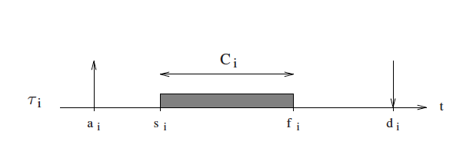
Characterizations of A Real-Time Task (4)
  Some of the parameters defined in the previous slides are illustrated in the following figure.

Slide 16
The Regularity of Activation
  Tasks can be defined as periodic or aperiodic.
  Periodic tasks consist of an infinite sequence of identical activities, called instances or jobs, that are regularly activated at a constant rate.
  Aperiodic tasks also consist of an infinite sequence of identical jobs (or instances);
    Their activations are not regularly interleaved.
  An aperiodic task where consecutive jobs are separated by a minimum inter-arrival time is called a sporadic task.

Slide 17
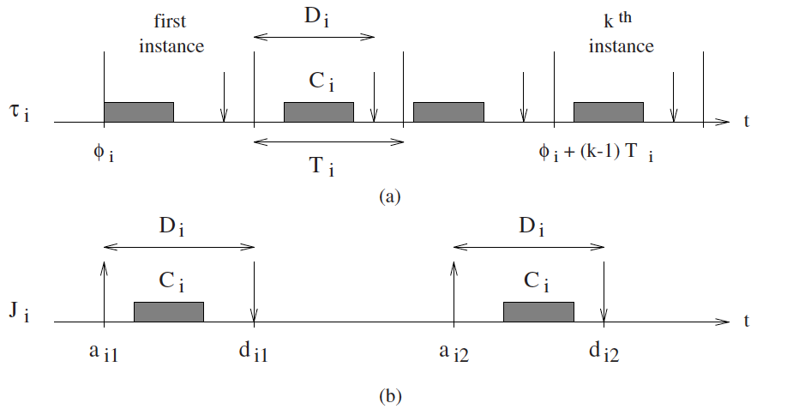
The Regularity of Activation (2)
  A periodic task τ_{i}; an aperiodic job J_{i}; the generic k^{th} job of a periodic task τ_{i,k}.
  The activation time of the first periodic instance (τ_{i},₁) is called phase.
    The activation time of the k^{th} instance is given by φ_{i}+(k−1)T_{i}.
    Note: T_{i} is the activation period of the task. A periodic process can be completely characterized by its phase φ_{i}, its computation time C_{i}, its period T_{i}, and its relative deadline D_{i}.

Slide 18
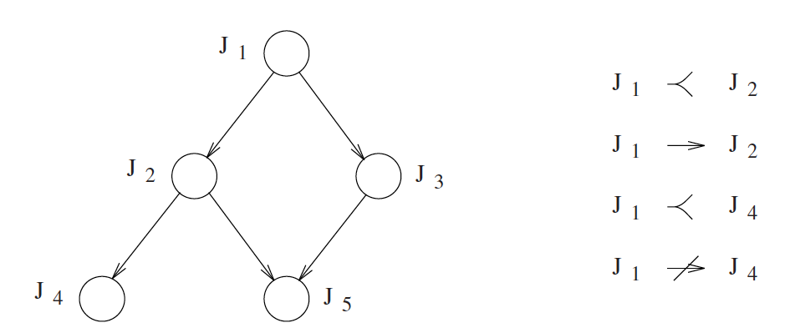
Precedence Constraints
  Precedence relations are usually described through a directed acyclic graph G.
    Tasks are represented by nodes and precedence relations by arrows
  The notation J_{a}≺J_{b} specifies that task J_{a} is a predecessor of task J_{b}, meaning that G contains a directed path from J_{a} to J_{b}.
  The notation J_{a}→J_{b} specifies that task J_{a} is an immediate predecessor of J_{b}, meaning that G contains an arc directed from node J_{a} to node J_{b}.
  Tasks with no predecessors: beginning tasks;
  Tasks with no successors: ending tasks

Slide 19
Resource Constraints
  From a process point of view, a resource is any software structure that can be used by the process to advance its execution.
  A resource dedicated to a particular process is said to be private, whereas a resource that can be used by more tasks is called a shared resource.
  Some resources:
    A data structure, a set of variables, a main memory area, a file, a piece of program, or a set of registers of a peripheral device.

Slide 20
A Mutually Exclusive Resource
  Many shared resources do not allow simultaneous accesses by competing tasks, but require their mutual exclusion.
    This means that a task cannot access a resource R if another task is inside R manipulating its data structures.
    In this case, R is called a mutually exclusive resource.
    A piece of code executed under mutual exclusion constraints is called a critical section.

Slide 21
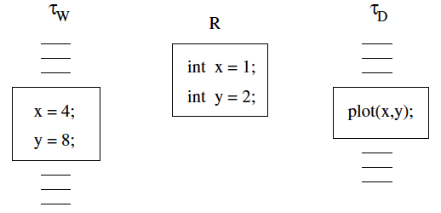
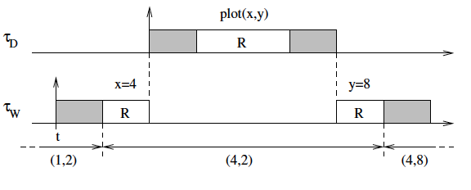
An Example of Mutual Exclusion
  Two tasks cooperate to track a moving object: task τ_{W} gets the object coordinates from a sensor and writes them into a shared buffer R, containing two variables (x, y); task τ_{D} reads the variables from the buffer and plots a point on the screen to display the object trajectory.

Slide 22
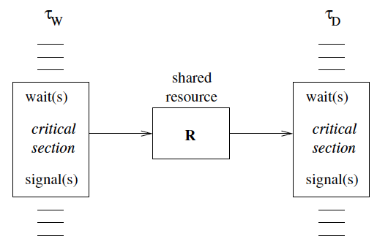
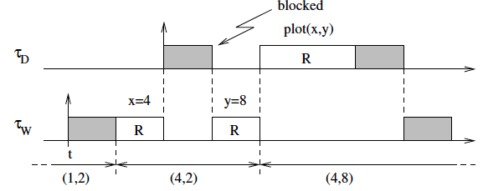
Solution: Semaphores

Slide 23
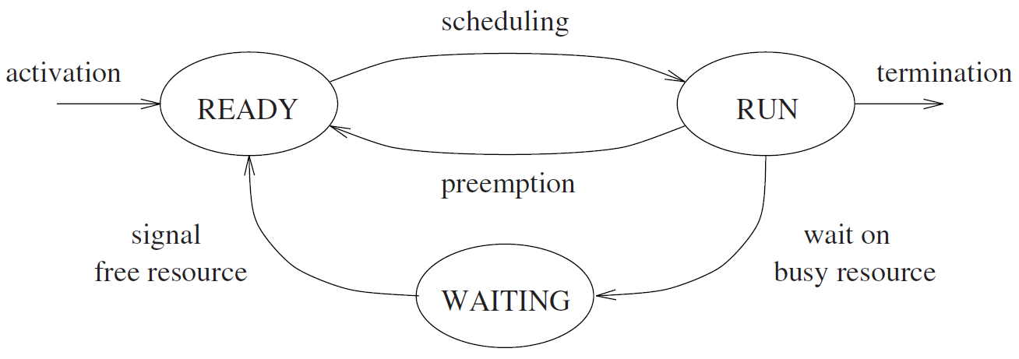
Waiting State
  When a running task executes a wait primitive on a locked semaphore, it enters a waiting state, until another task executes a signal primitive that unlocks the semaphore.
    Note that when a task leaves the waiting state, it does not go in the running state, but in the ready state, so that the CPU can be assigned to the highest-priority task by the scheduling algorithm.

Slide 24
Definition of Scheduling Problems
  A set of n tasks Γ = {τ₁, τ₂, . . . , τ_{n}},
  A set of m processors P = {P₁, P₂, . . . , P_{m}}
  A set of s types of resources R = {R₁, R₂, . . . , R_{s}}
  Precedence relations among tasks can be specified through a directed acyclic graph, and timing constraints can be associated with each task.
  Scheduling means assigning processors from P and resources from R to tasks from Γ in order to complete all tasks under the specified constraints.
  This problem, in its general form, has been shown to be NP-complete [GJ79] and hence computationally intractable.

Slide 25
Time Complexity of Online Scheduling Problems
  The complexity of scheduling algorithms is of high relevance in dynamic real-time systems.
    Scheduling decisions must be taken online during task execution.
  A polynomial algorithm is one whose time complexity grows as a polynomial function p of the input length n of an instance.
    The complexity of such algorithms is denoted by O(p(n)).
    Each algorithm whose complexity function cannot be bounded in that way is called an exponential time algorithm.
    The online scheduling problems must be solved in polynomial time.

Slide 26
Classification of Scheduling Algorithms
  Preemptive vs. Non-preemptive
    In preemptive algorithms, the running task can be interrupted at any time to assign the processor to another active task, according to a predefined scheduling policy.
    In non-preemptive algorithms, a task, once started, is executed by the processor until completion. In this case, all scheduling decisions are taken as the task terminates its execution.
  Static vs. Dynamic
    Static algorithms are those in which scheduling decisions are based on fixed parameters, assigned to tasks before their activation.
    Dynamic algorithms are those in which scheduling decisions are based on dynamic parameters that may change during system evolution.

Slide 27
Classification of Scheduling Algorithms (2)
  Off-line vs. Online
    A scheduling algorithm is used off line if it is executed on the entire task set before tasks activation. The schedule generated in this way is stored in a table and later executed by a dispatcher.
    A scheduling algorithm is used online if scheduling decisions are taken at runtime every time a new task enters the system or when a running task terminates.
  Optimal vs. Heuristic
    An algorithm is optimal if it minimizes some given cost function defined over the task set. When no cost function is defined and the only concern is to achieve a feasible schedule, then an algorithm is optimal if it is able to find a feasible schedule, if one exists.
    An algorithm is heuristic if it is guided by a heuristic function in taking its scheduling decisions. A heuristic algorithm tends toward the optimal schedule, but does not guarantee finding it.

Slide 28
Guarantee-Based Algorithms
  In hard real-time applications that require highly predictable behavior, the feasibility of the schedule should be guaranteed in advance.
    Before task execution
  Checking the feasibility of the schedule before tasks’ execution
  Assuming a worst-case scenario
  In static real-time systems, where the task set is fixed and known a priori, all task activations can be precalculated offline, and the entire schedule can be stored in a table that contains all guaranteed tasks arranged in the proper order.

Slide 29
Guarantee-Based Algorithms (2)
  At runtime, a dispatcher simply removes the next task from the table and puts it in the running state.
  The main advantage of the static approach is that the runtime overhead does not depend on the complexity of the scheduling algorithm.
  This allows very sophisticated algorithms to be used to solve complex problems or find optimal scheduling sequences.
  On the other hand, however, the resulting system is quite inflexible to environmental changes; thus, predictability strongly relies on the observance of the hypotheses made on the environment.

Slide 30
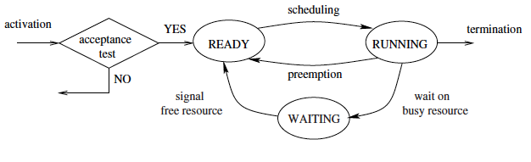
Guarantee-Based Algorithms (3)
  Dynamic real-time systems (typically consisting of firm tasks)
    Tasks can be created at runtime
    The guarantee must be done online every time a new task is created.

Slide 31
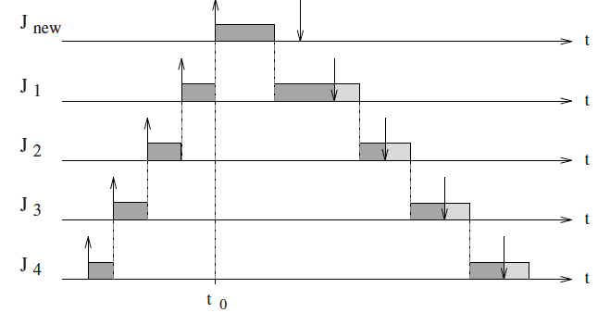
Domino Effect
  The benefit of having a guarantee mechanism is that potential overload situations can be detected in advance to avoid negative effects on the system.
  One of the most dangerous phenomena caused by a transient overload is called domino effect.
    It refers to the situation in which the arrival of a new task causes all previously guaranteed tasks to miss their deadlines.

Slide 32
Best-Effort Algorithms
  In certain real-time applications, computational activities have soft timing constraints.
    Missing soft deadlines do not cause catastrophic consequences, but only a performance degradation.
  For example: Typical multimedia applications
    The objective: Handling different types of information (such as text, graphics, images, and sound) in order to achieve a certain quality of service for the users
    Missing a deadline may only affect the performance of the system.
  To efficiently support soft real-time applications, a best-effort approach may be adopted for scheduling.
    There is no guarantee of finding a feasible schedule.
    Best-effort algorithms perform much better than guarantee-based schemes in the average case.

Slide 33
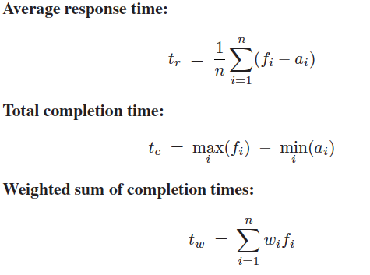
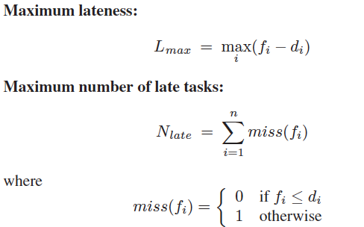
Metrics for Performance Evaluation
  The performance of scheduling algorithms is typically evaluated through a cost function defined over the task set.
    For example, classical scheduling algorithms try to:
      Minimize the average response time, the total completion time, the weighted sum of completion times, or the maximum lateness.

Slide 34
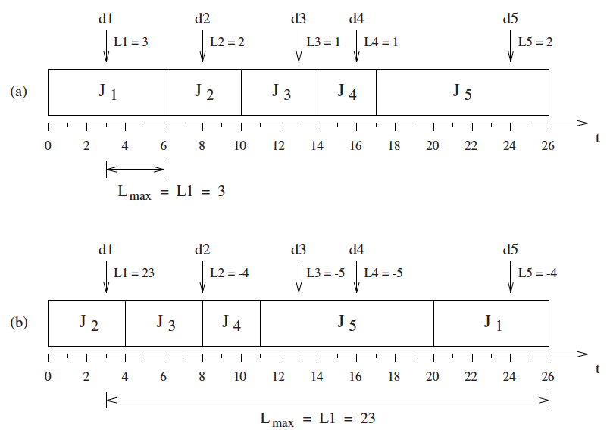
Example
  The schedule minimizes the maximum lateness, but all tasks miss their deadline. The schedule shown in Figure b has a greater maximum lateness, but four tasks out of five complete before their deadline.

Slide 35
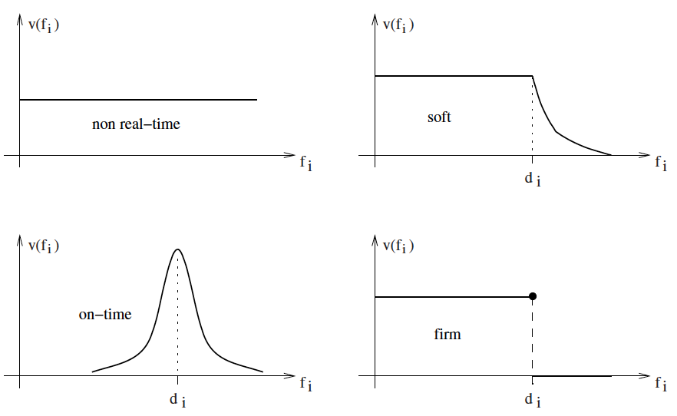
Utility Functions
  Utility function: The value associated with the task as a function of its completion time.
    The benefit of executing a task may depend not only on the task importance but also on the time at which it is completed

Slide 36
Scheduling Anomalies
  Real-time computing is not equivalent to fast computing.
  Richard’s anomalies were described by Graham in 1976 and refer to task sets with precedence relations executed in a multiprocessor environment.
Theorem (Graham, 1976). If a task set is optimally scheduled on a multiprocessor with some priority assignment, a fixed number of processors, fixed execution times, and precedence constraints, then increasing the number of processors, reducing execution times, or weakening the precedence constraints can increase the schedule length.

Slide 37
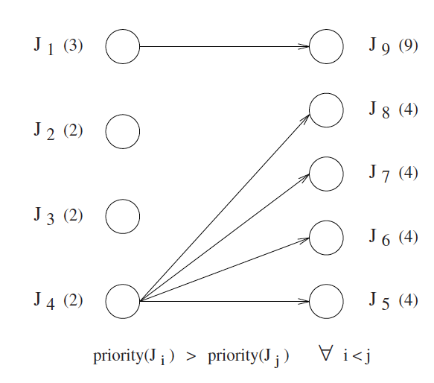
An Example of Graham’s Theorem
  Let us consider a task set consisting of nine jobs J = {J₁, J₂, ... , J₉}, sorted by decreasing priorities, so that J_{i} priority is greater than J_{j} priority if and only if i < j.

Slide 38
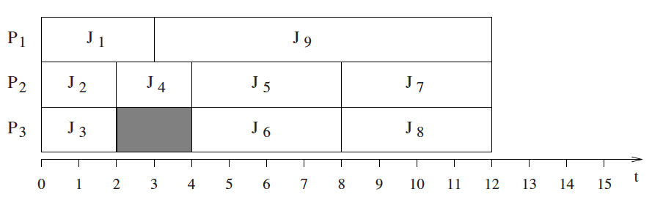
An Example of Graham’s Theorem (2)
  If this task set is executed on a platform with three processing cores, where the highest priority task is assigned to the first available core, the resulting schedule σ∗ is illustrated in following figure, where the global completion time is t_{c} = 12 units of time.

Slide 39
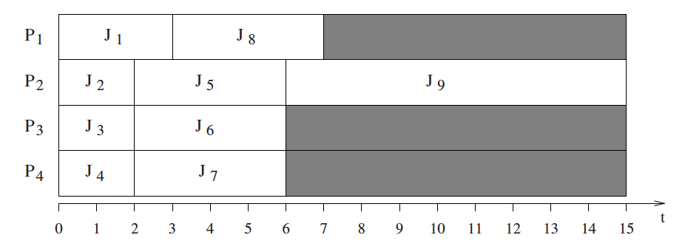
An Example of Graham’s Theorem: Number of Processing cores increased
  Considering four processing cores
  Obtaining the schedule which is characterized by a global completion time of t_{c} = 15 units of time.

Slide 40
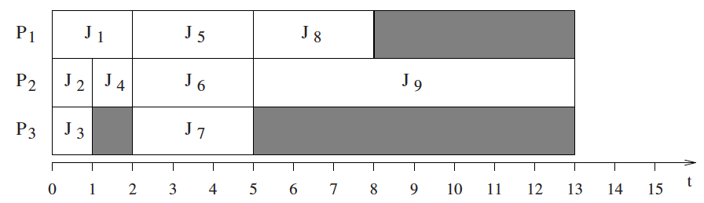
An Example of Graham’s Theorem: Computation Times Reduced
  One could think that the global completion time of the task set J could be improved by reducing tasks’ computation times of each task. However, reducing the computation time of each task by one unit of time, the schedule length will increase with respect to the optimal schedule σ∗, and the global completion time will be t_{c} = 13.

Slide 41
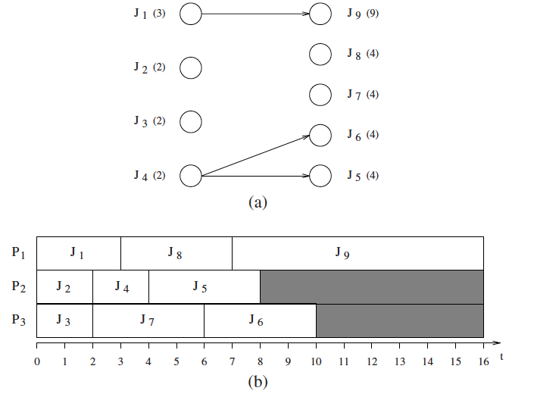
An Example of Graham’s Theorem: Precedence Constraints Weakened
  Removing the precedence relations between job J₄ and jobs J₇ and J₈
    Obtaining the schedule which is characterized by a global completion time of t_{c} = 16 units of time.

Slide 42
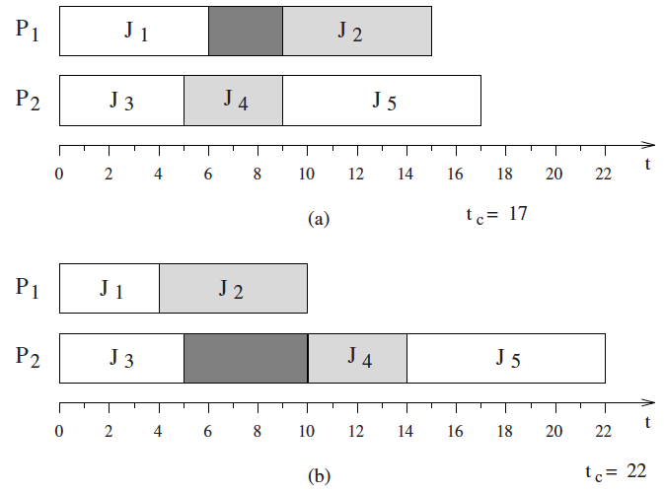
An Example of Graham’s Theorem: Anomalies under Resource Constraints
  Five jobs are statically allocated on two processors:
    Jobs J₁ and J₂ on processor P₁, and jobs J₃, J₄ and J₅ on processor P₂ (jobs are indexed by decreasing priority).
    Jobs J₂ and J₄ share the same resource in exclusive mode; hence their execution cannot overlap in time.
  The total completion time is t_{c} = 17.

Slide 43
An Example of Graham’s Theorem: Anomalies under Resource Constraints (2)
  Reducing the computation time of job J₁ on the first core, then J₂ can begin earlier and take the resource before J₄. As a consequence, job J₄ must now block over the shared resource and possibly miss its deadline.
  The blocking time experienced by J₄ causes a delay in the execution of J₅ (which may also miss its deadline), increasing the total completion time of the task set from 17 to 22.

Slide 44
An Example of Graham’s Theorem: Anomalies under Resource Constraints (Increasing Speed)
  A real-time application that is feasible on a given processor can become infeasible when running on a faster processor.

Slide 45
An Example of Graham’s Theorem: Anomalies under Non-Preemptive Scheduling
  Tasks are assigned a fixed priority proportional to their relative deadline, thus τ₁ is the task with the highest priority and τ₃ is the task with the lowest priority.
  If task set is executed with double speed S₂=2S₁, τ₁ misses its deadline.
    This happens because, when τ₁ arrives, τ₃ already started its execution and cannot be preempted (due to the non-preemptive mode).

Slide 46
An Example of Graham’s Theorem: Anomalies Using A Delay Primitive
  Another timing anomaly can occur when tasks using shared resources explicitly suspend themselves through a delay(T) system call, which suspends the execution of the calling task for T units of time.

Slide 47
An Example of Graham’s Theorem: Anomalies Using A Delay Primitive (2)
  Another case in which the suspension of a task can also cause a longer delay in a different task, even without sharing any resource.

Slide 48
Summary
  Definition of Process, Scheduling, Ready Queue, and etc.
  Preemption
  Types of Tasks Constraints
  Characterizations of Real-Time Tasks
  Precedence and Resource Constraints
  References

